Slide 1
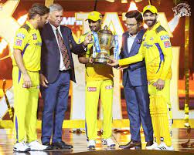
CSK
champions
The champions of 2023!

Slide 2
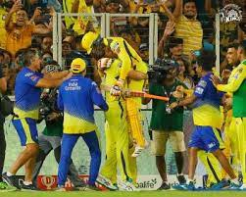
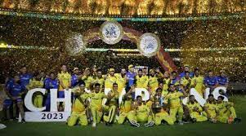
The 5 times champions
THE JADU FINSH EMOTION OF THALA
THE 5 ^{th} Trophy OF CSK

Slide 3
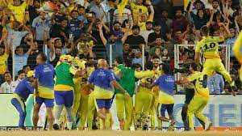
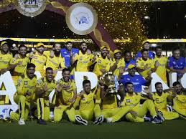
THE ROARING OF THE LIONS

Slide 4
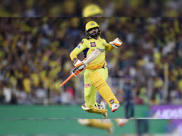
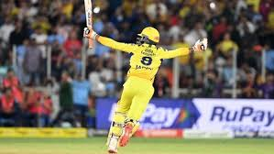
THE RISE OF NEXT FINSHER
Starting the journey of yelove from 2010
SIR R.JADU

Slide 5
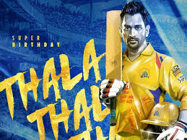
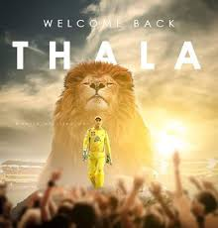
THALA MSD RETURN

Slide 6
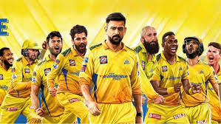
WHISTLE PODU

Slide 7
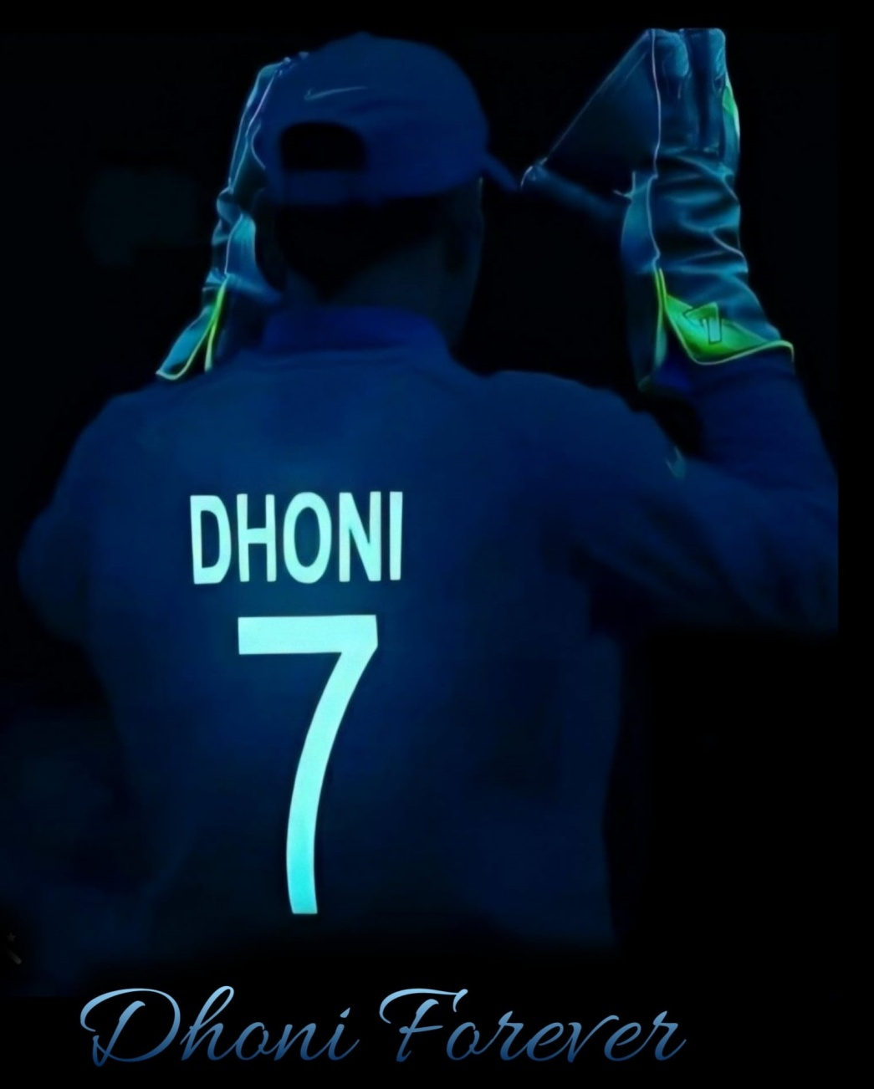
THE WINING IS NEVER END

Slide 8
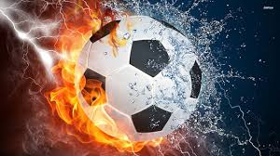
FOOTBALL

Slide 9
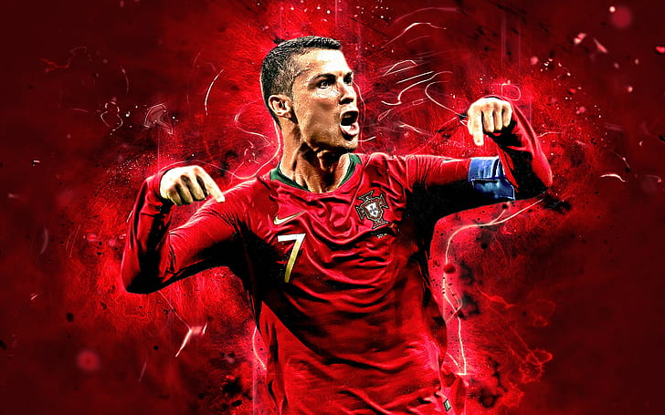
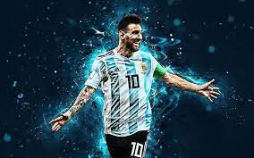
Famous players of football

Slide 10
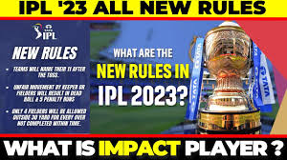
THE RULES OF CRICKET

Slide 11
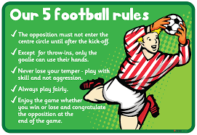
Foot ball rules

Slide 12
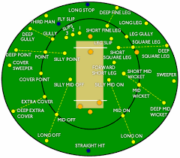
Cricket Field Diagram

Slide 13
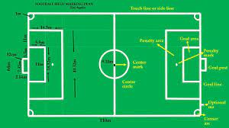
FOOTBALL FIELD DIAGRAM

Slide 14
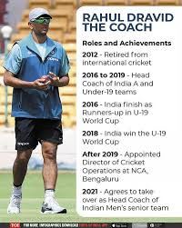
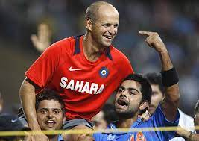
THE GREAT COCHES OF CRICKET

Slide 15
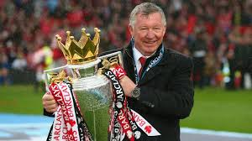
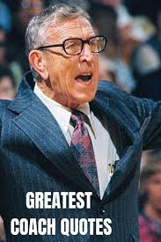
THE GREAT COACHES OF FOOTBALL

Slide 16
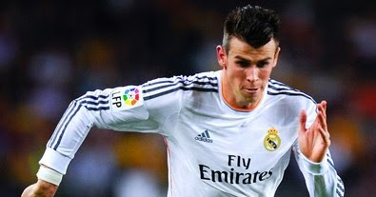
Fastest player of foot ball

Slide 17
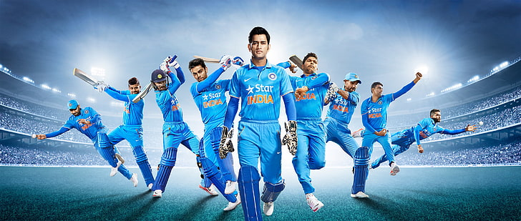
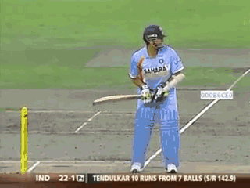
Fastest players of cricket

Slide 18
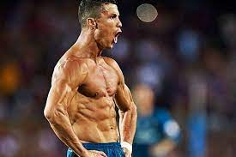
Fitness player of football

Slide 19
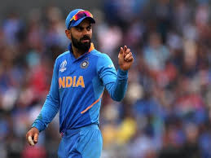
FITNESS PLAYER IN CRICKET

Slide 20
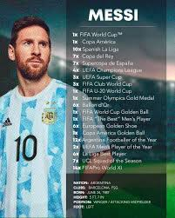
The best player of all

Slide 21
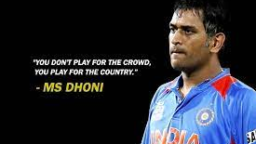
“NOTHING IS IMPORTANT OTHER THAN OUR COUNTRY.”
By naresh

Slide 22
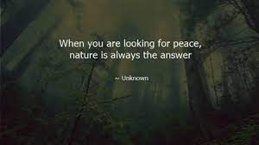
“LOOKDEEP INTO NATURE THAN YOU UNDERSTAND EVERYTHING IN THE WORLD.”
By albert einstein

Slide 23
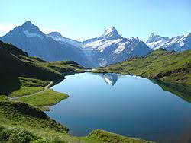
THE NATURE

Slide 24
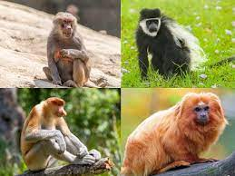
The verity of monkey

Slide 25
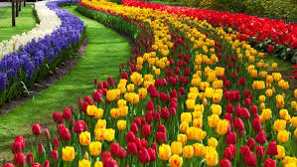
THE WONDERFUL FLOWERS

Slide 26
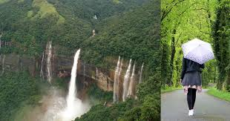
GREENISH LANDS OF THE WORLD

Slide 27
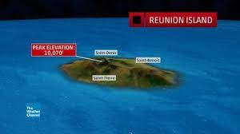
THE HIGHIEST RAIN FALL RECORDING ISLAND

Slide 28
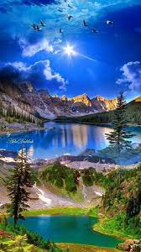
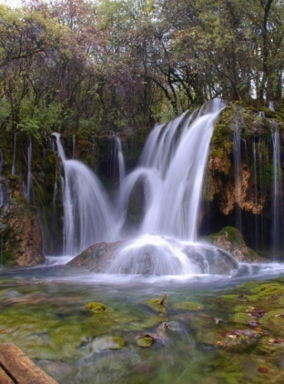
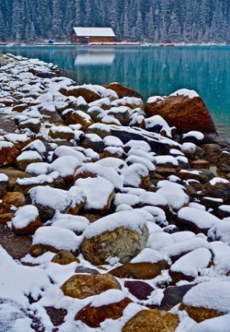
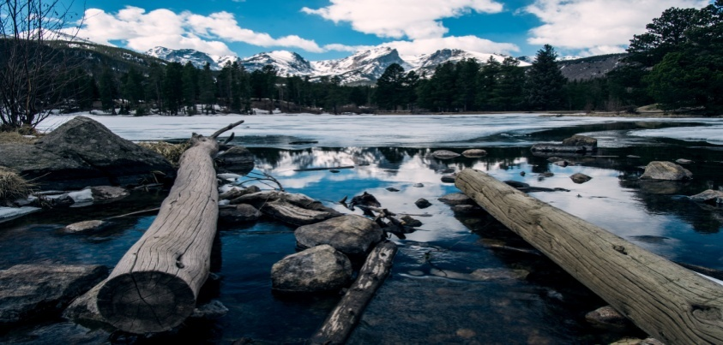
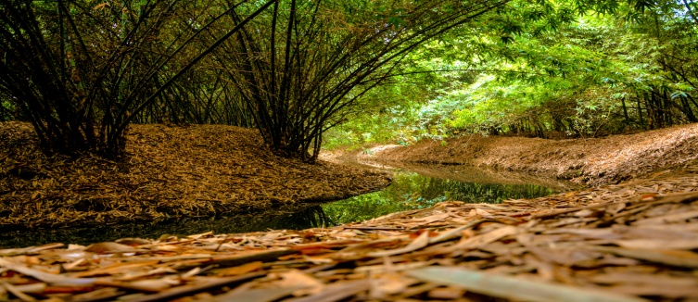
The nature gift for the humans and animals

Slide 29
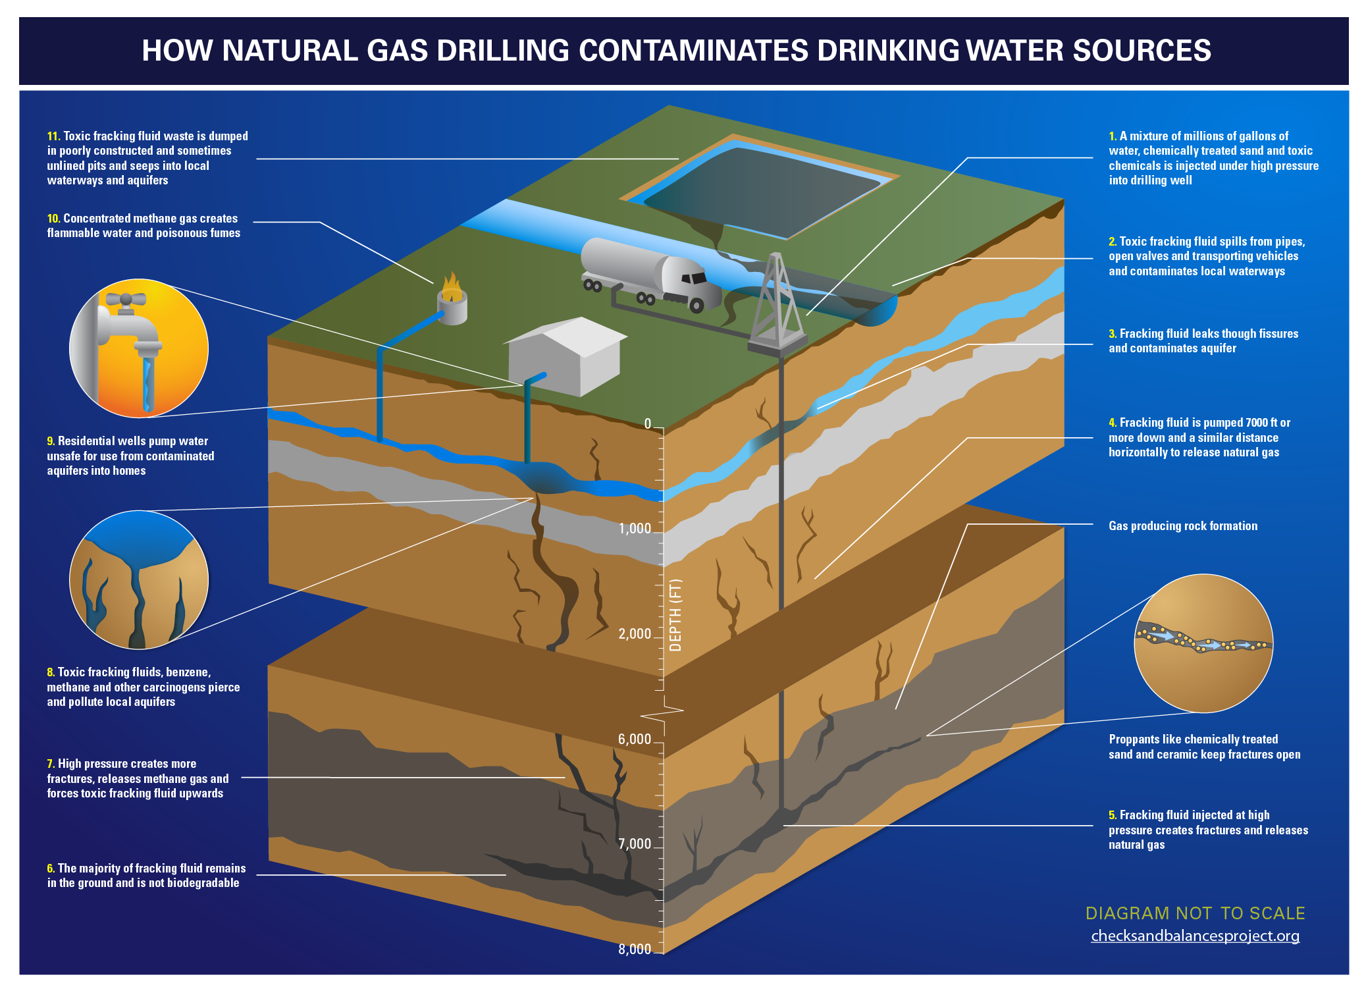
The Formation of drinking water by using the nature

Slide 30
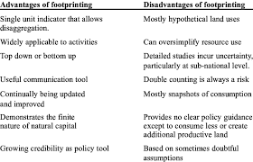
Advantages and disadvantages of nature

Slide 31
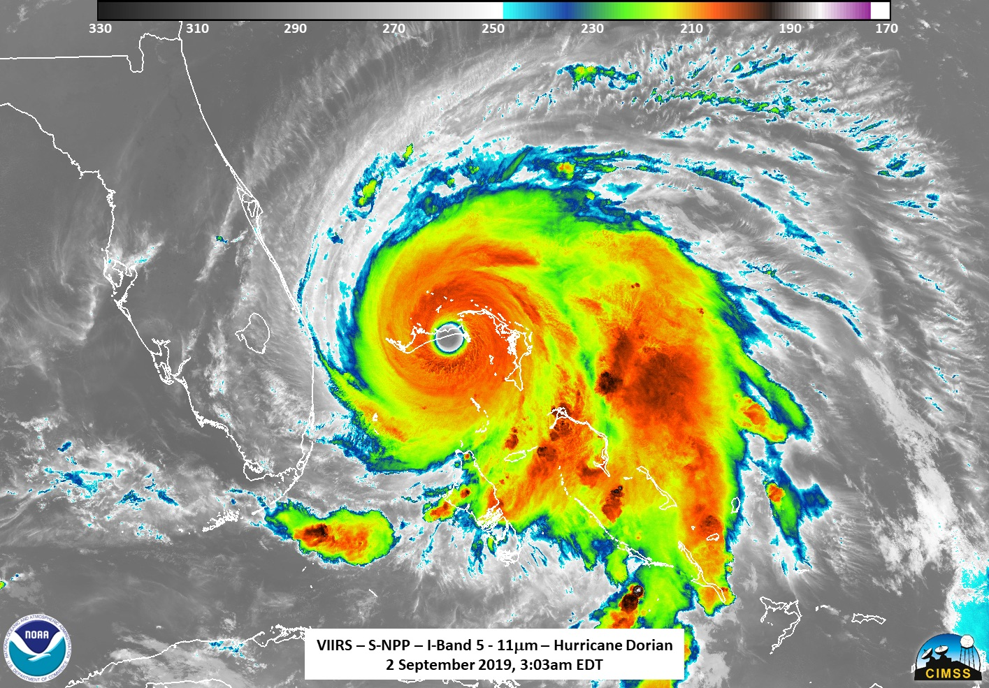
The famous and dangerous cyclone of world

Slide 32
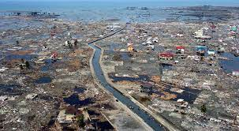
The destroy of chennai in 2004 by the tsunami

Slide 33
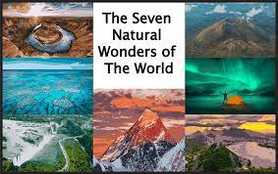
Wonders of nature

Slide 34
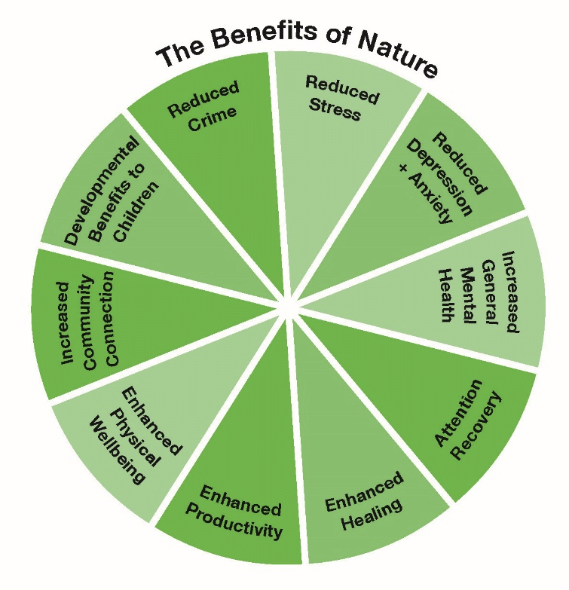
The Benefits of nature

Slide 35
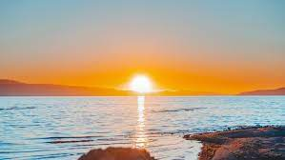
The riseing of sun in our world

Slide 36
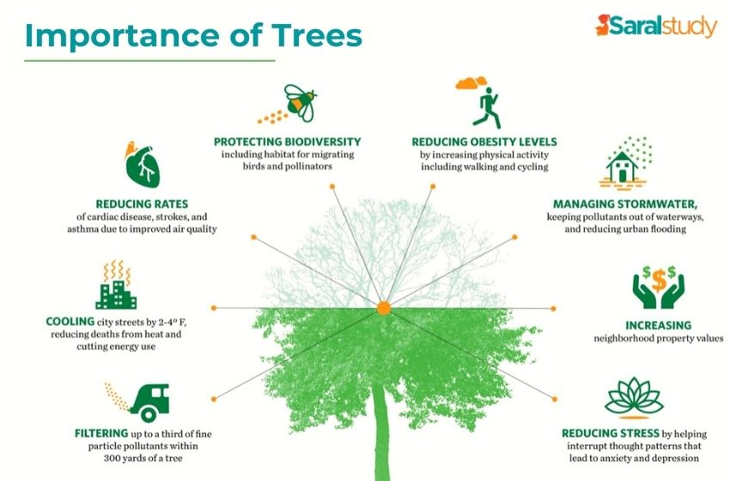
Use of trees by the humans

Slide 37

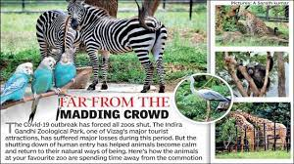
The various zoo and parks that protect our lifes and our next generations

Slide 38
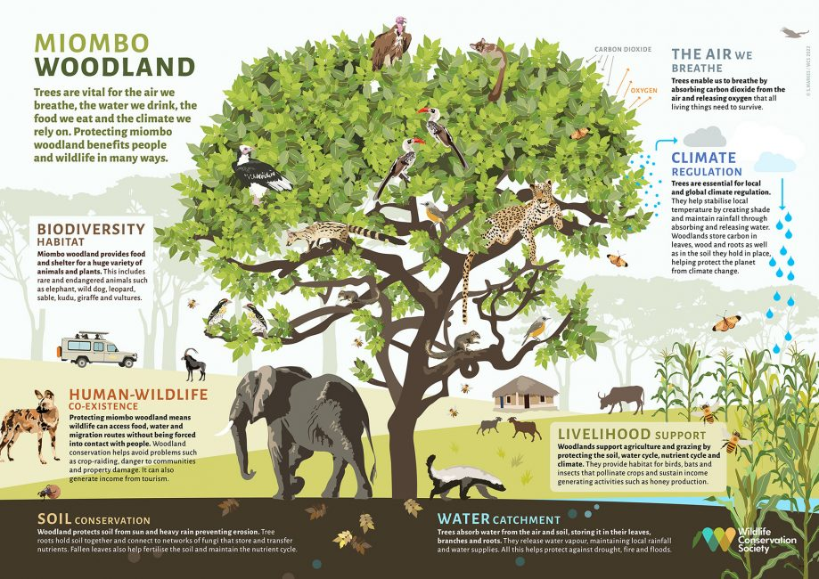
Ecosystem of nature and animals

Slide 39


Bad habbits that was doing by humans to destroy our nature
The major cause polluting the nature
B y destroying the tree our lifes is also get destroy

Slide 40

Save our nature and animals because it will saves us later .people should under stand to save our natures some of the precautions to protect our nature are us follows
The end

